Slide 1
FWT ROLLING UPDATE 09.03.2022 CG GS

Slide 2
FWT1030
DESMEAR DOE 2x, 1x, 0x
→FIRST RESULTS

Slide 3
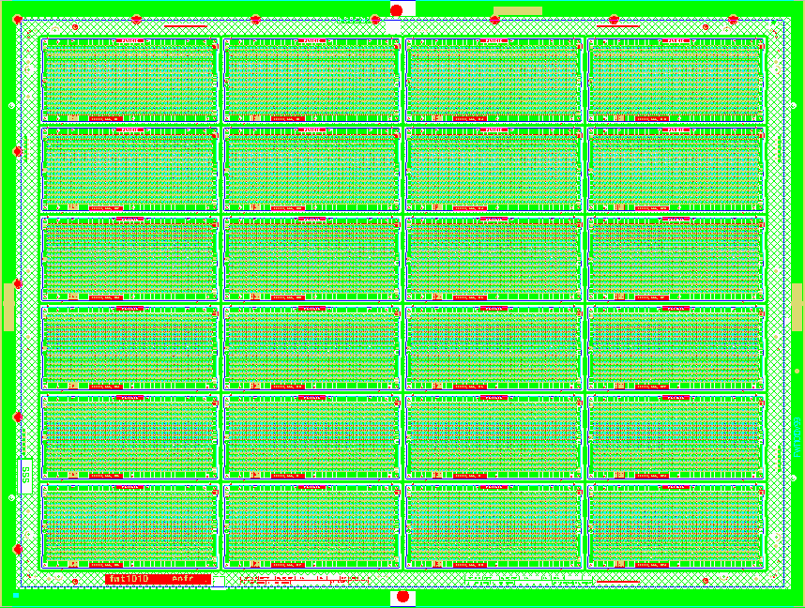
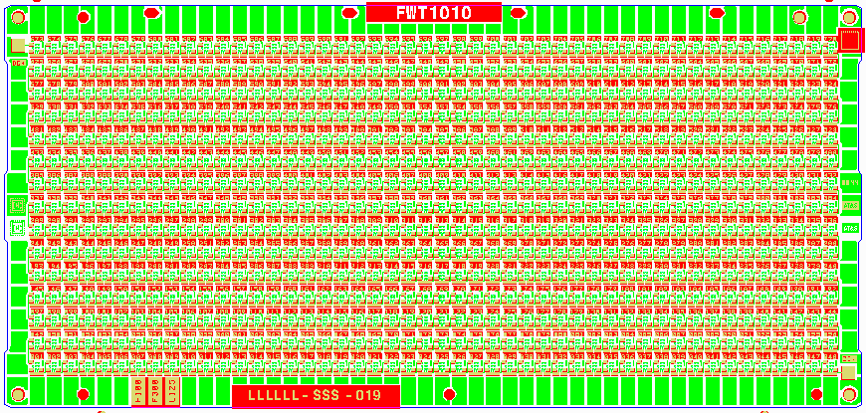
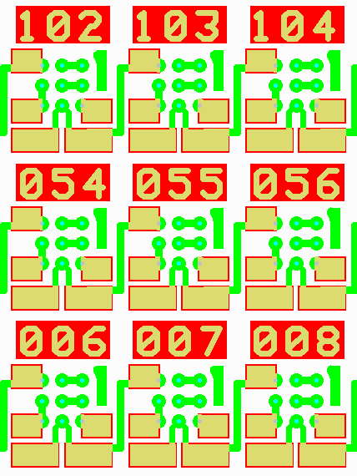
FWT1030

Slide 4
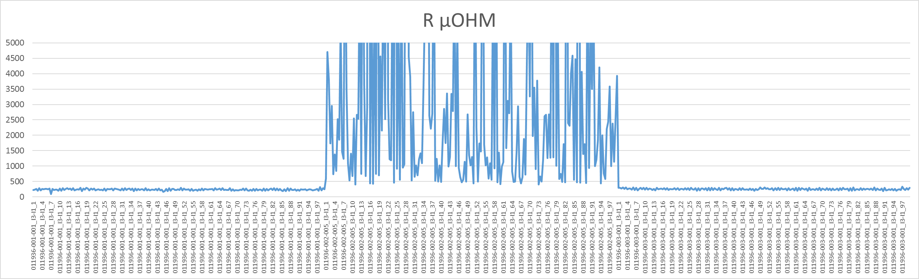
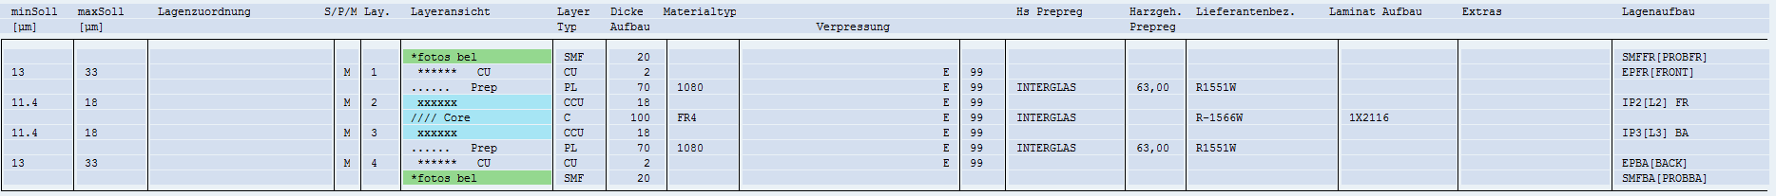
FWT1030 →Mat R1551W, R1566W
MEAN NO DESMEAR = 3546 µOHM
MEAN STD = 236 µOHM
MEAN 50%STD = 252 µOHM

Slide 5
FWT0050 – FWT0102 →FIRST RESULTS

Slide 6
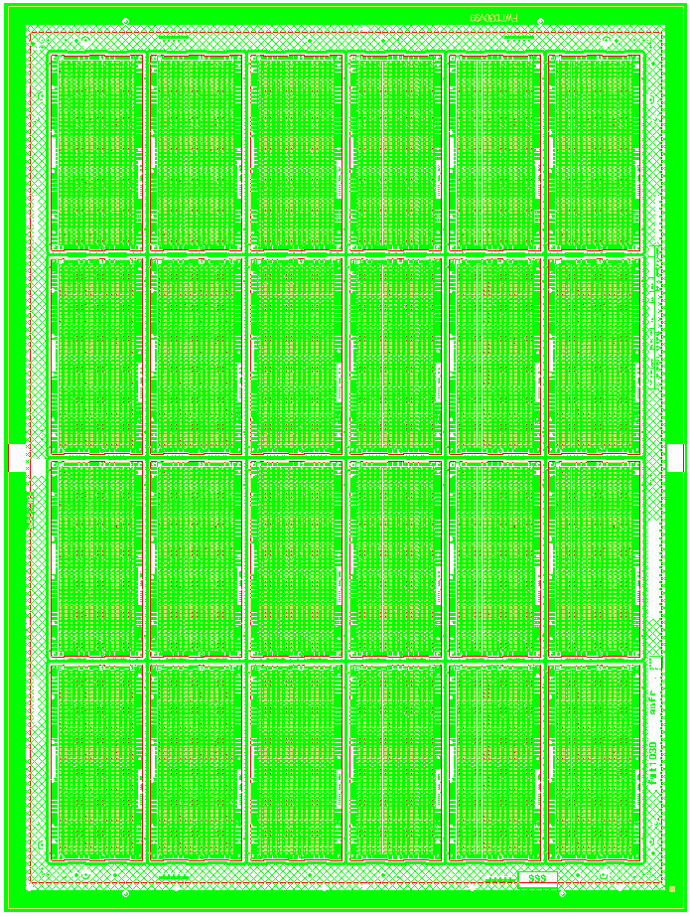
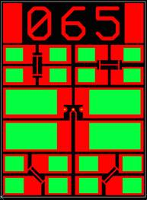
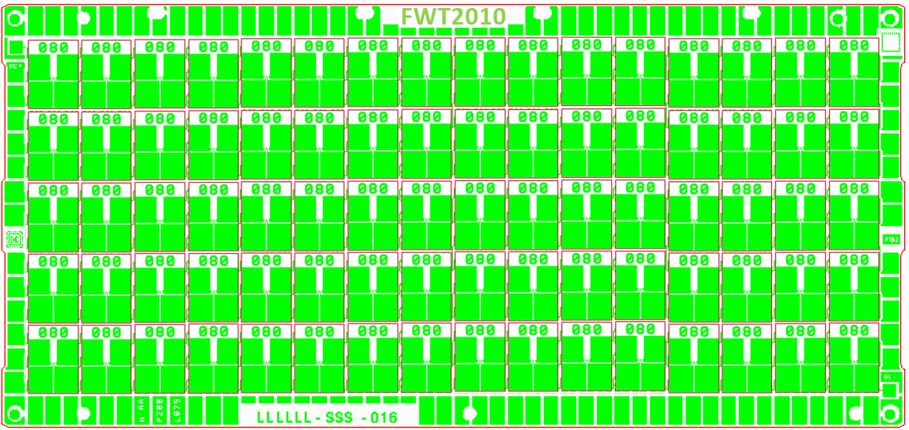
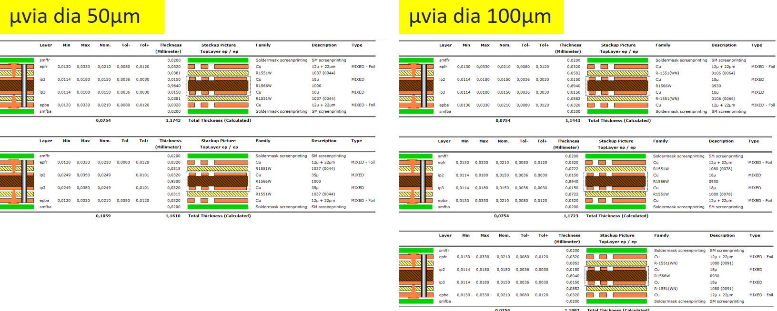
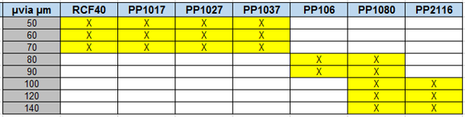
FWT0050 – FWT0102 →FIRST RESULTS
SENSE + SENSE -
FORCE + FORCE -
3840 FWTµvias
Front & Back
S+
F+
S+
F+
F-
S-
F-
S-
S+
F+
F-
S-
S+
F+
S+
F+
F-
S-
F-
S-
Currently in Production

Slide 7
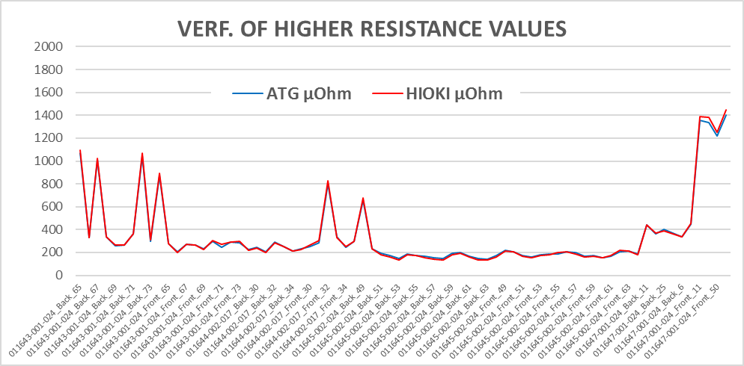
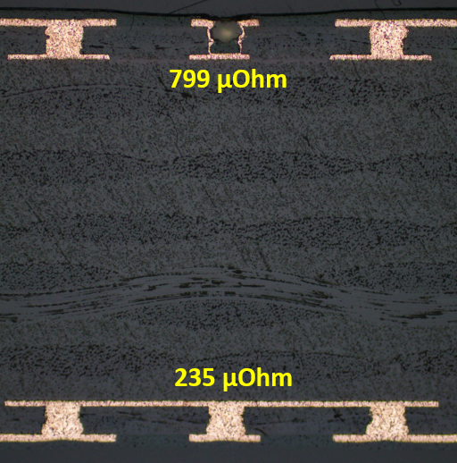
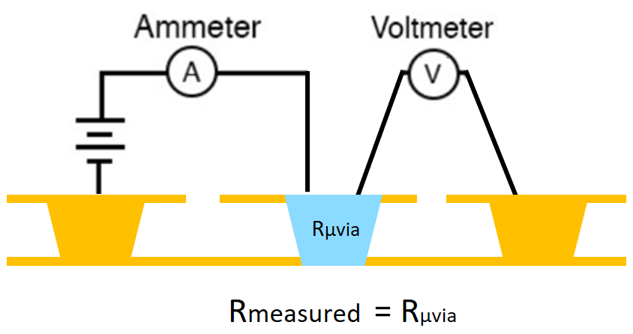


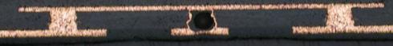
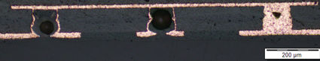
FWT0050 – FWT0102 →FIRST RESULTS
FWT0101
FWT0050
FWT0101
FWT0100
FWT0102

Slide 8
FWT DESIGN FOR PTH (DESMEAR)

Slide 9
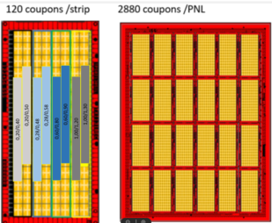
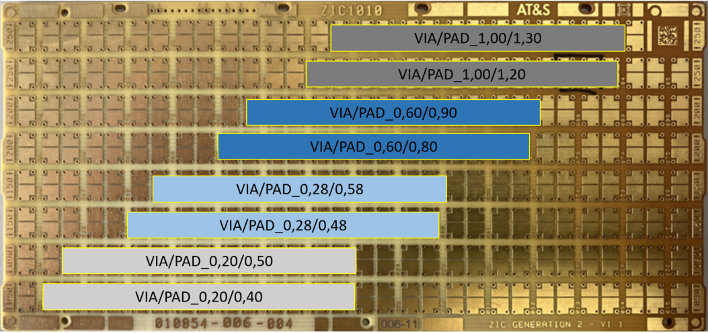
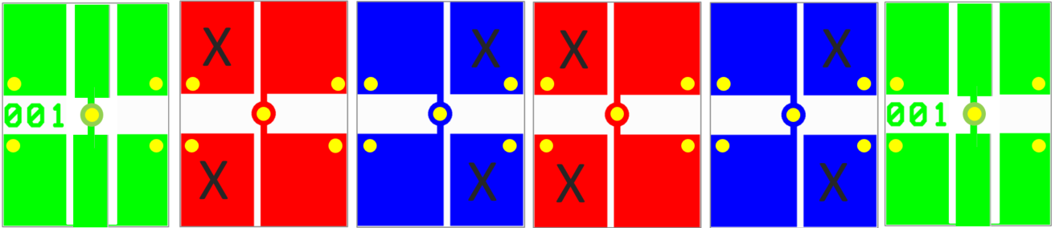
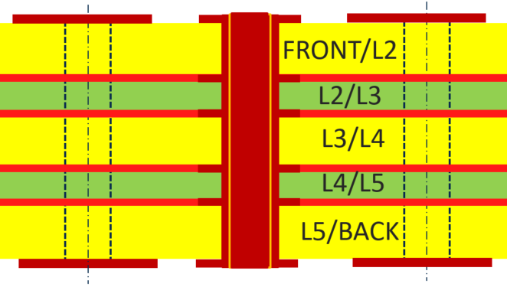
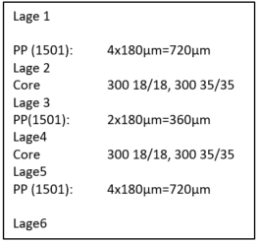
FWT DESIGN FOR PTH (DESMEAR)
FRONT L2 L3 L4 L5 BACK

Slide 10
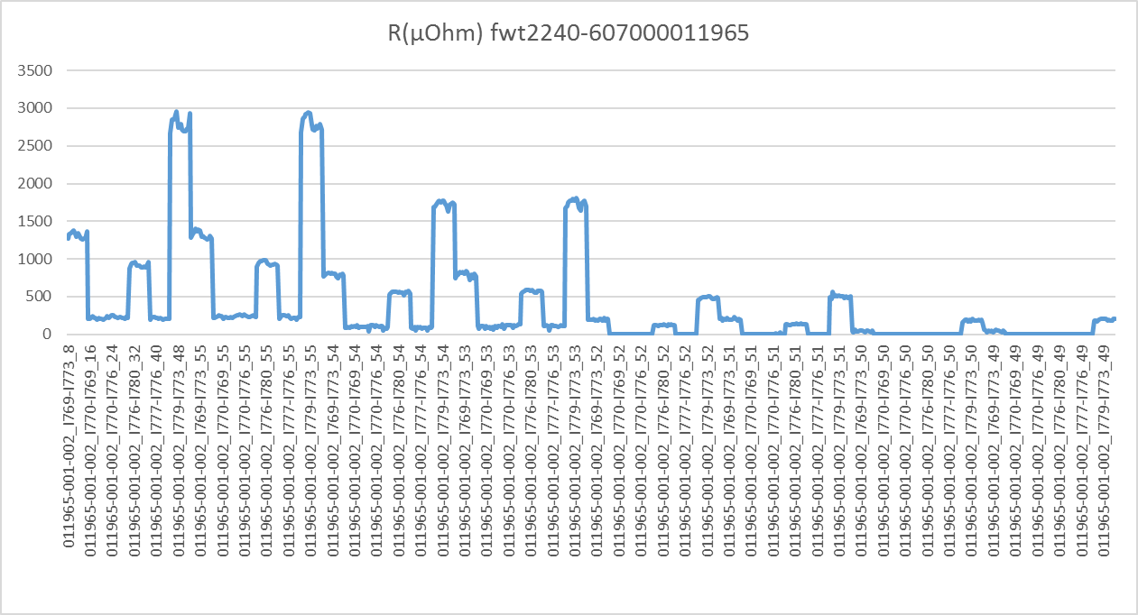
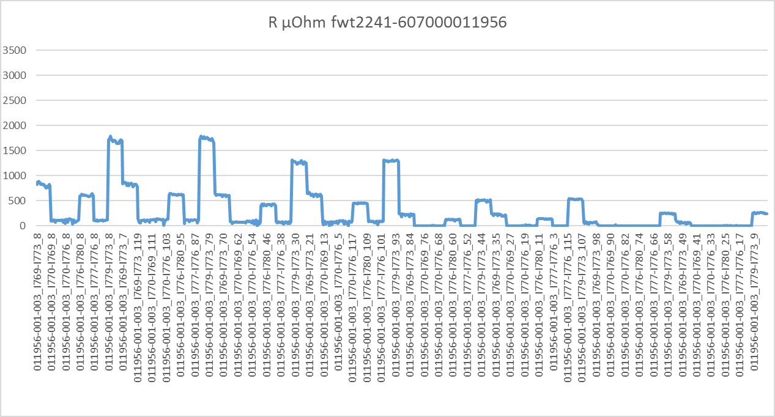
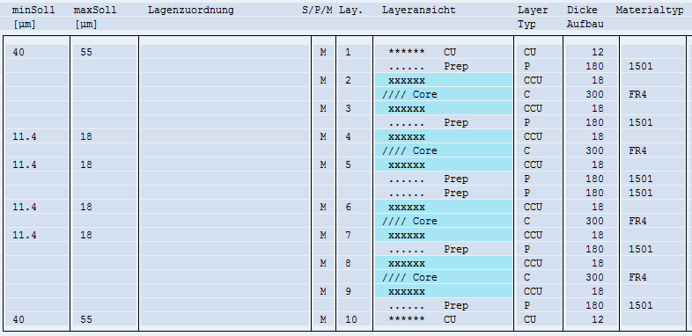
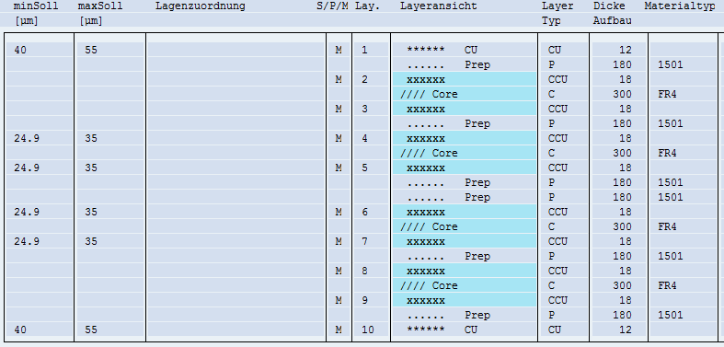
FWT DESIGN FOR PTH (DESMEAR)
0,2mm 0,28mm 0,6mm 1,0mm
0,2mm 0,28mm 0,6mm 1,0mm
35µm
18µm
IP copper 18µm show higher resistance values than IP Copper 35µm

Slide 11
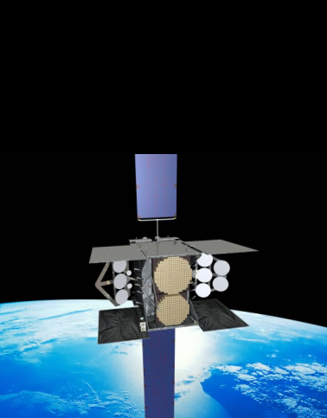
FWT Coupon Project WGS
Wideband Global SATCOM
Christian Galler, Gerhard Stubenberger
Quality Management, Department
November 16, 2021

Slide 12
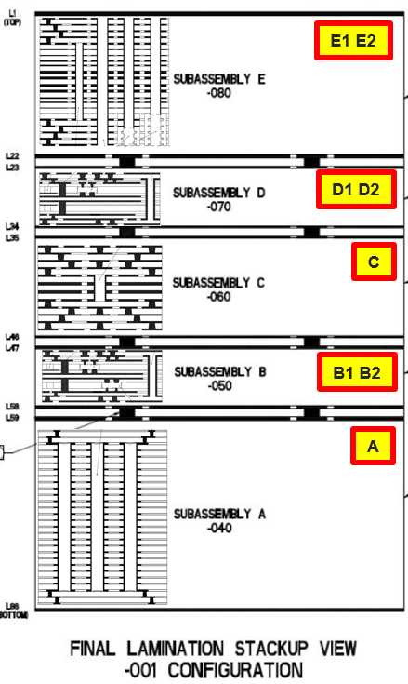
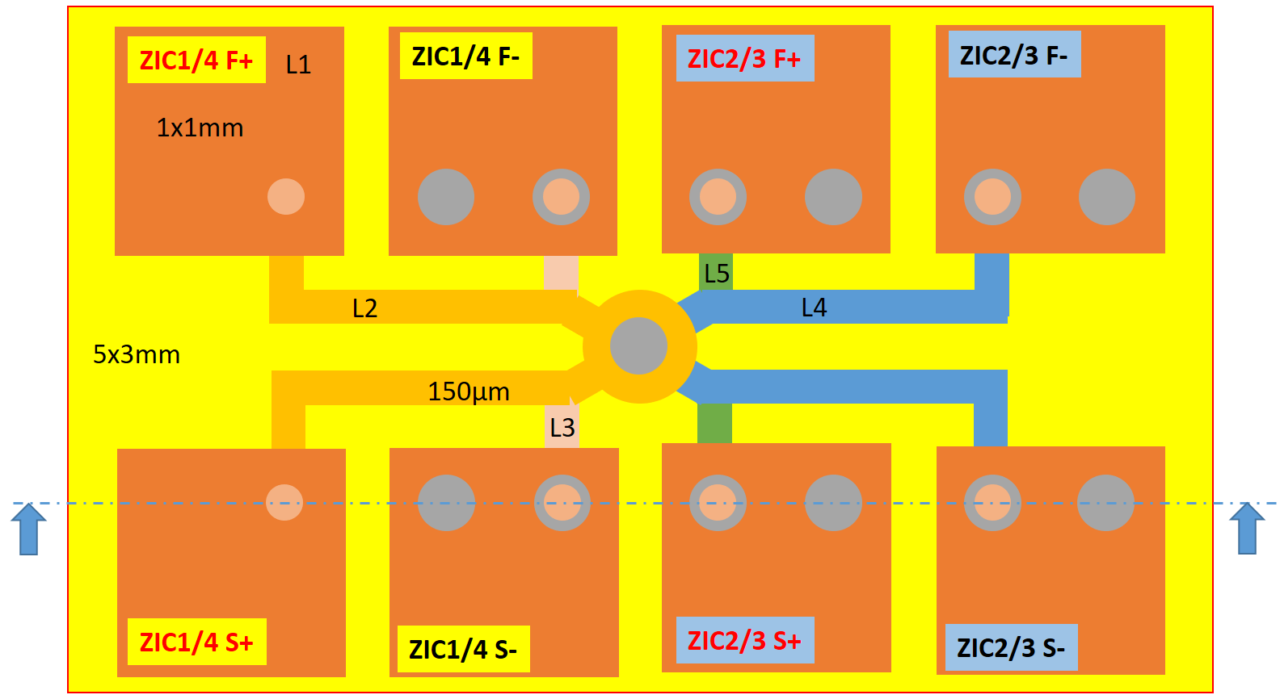
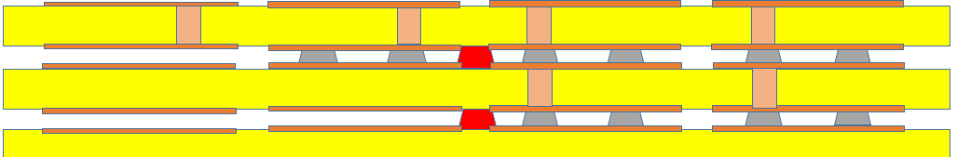
FWT-Coupon ZIC
ZIC1
ZIC2
ZIC3
ZIC4
SCHNITT A-A
ZIC1
ZIC2
ZIC3
ZIC4

Slide 13
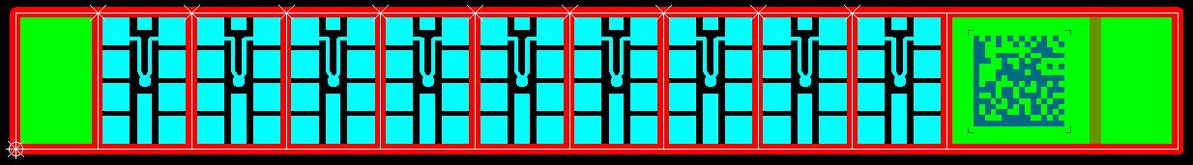
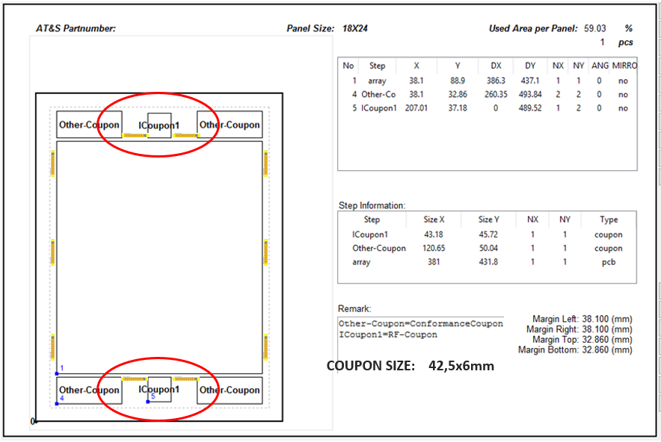
ZIC Coupon Positions
COUPON SIZE: 42,5x6mm

Slide 14
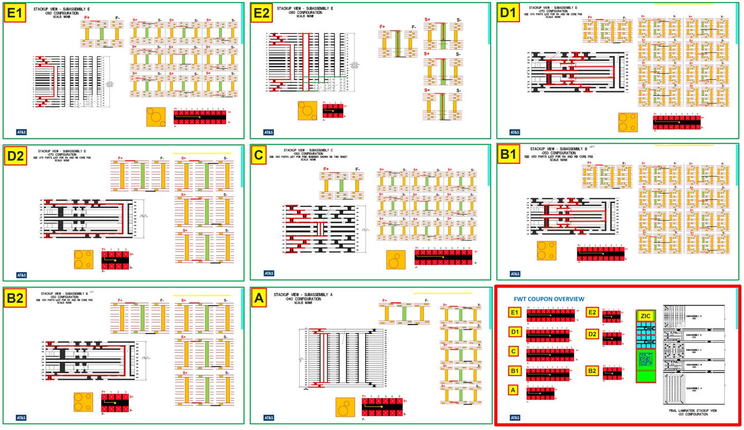
FWT COUPONS

Slide 15
Thank You for your attention

